Slide 1





Optimizing Promotional Product Groupings in the Retail Industry
`

Slide 2

AGENDA
Introduction and Problem Statement
Modeling and Results
Future Scope
`

Slide 3





OUR TEAM
Rahul Raj
Xuanming Hu
Vinitha Ravindran
Siddharth Harisankar
Mehul Zawar
15+ years of cumulative experience in Analytics and Consulting domain
`

Slide 4
AGENDA
Introduction and Problem Statement
Modeling and Results
Future Scope
`

Slide 5







The use of PPGs transcends industries
`

Slide 6




CURRENT SCENARIO
PPG analysis conducted manually
Human errors
Lack of robust framework
`

Slide 7



OUR SOLUTION
Forming optimal PPG bundles that boost sales and provide decision support to the business
`

Slide 8
AGENDA
Introduction and Problem Statement
Modeling and Results
Future Scope
`

Slide 9




WHY OPTIMIZATION?
Consumer
Needs
Optimized
Solution
Keep the prices down
Enhance customer experience
Maximize revenue
Improve consumer’s willingness to pay
`

Slide 10
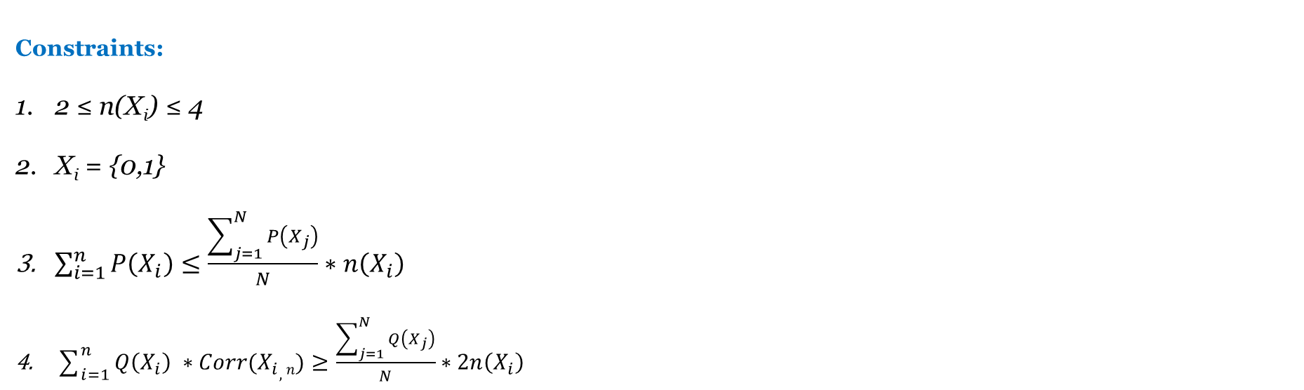
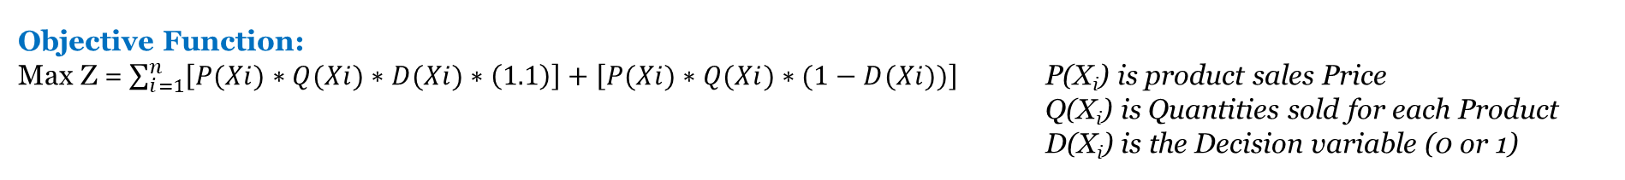
Framing of Optimization Problem
Objective Function:
Max Z = $\sum_{i=1}^{n}{\left[P(Xi)∗Q(Xi)∗D(Xi)∗\left(1.1\right)\right]+\left[P(Xi)∗Q(Xi)∗(1−D(Xi))\right]}$ P(X_{i}) is product sales Price
Q(X_{i}) is Quantities sold for each Product
D(X_{i}) is the Decision variable (0 or 1)
Decision Variables:
List of X_{i} to include to form PPG bundle. X_{i} is individual product
Constraints:
2 ≤ n(X_{i}) ≤ 4
X_{i} = {0,1}
$\sum_{i=1}^{n}{P\left(X_{i}\right)}≤\frac{\sum_{j=1}^{N}{P\left(X_{j}\right)}}{N}∗n\left(X_{i}\right)$
$\sum_{i=1}^{n}{Q\left(X_{i}\right) ∗Corr(X_{i},n)}≥\frac{\sum_{j=1}^{N}{Q\left(X_{j}\right)}}{N}∗2n\left(X_{i}\right)$
`

Slide 11
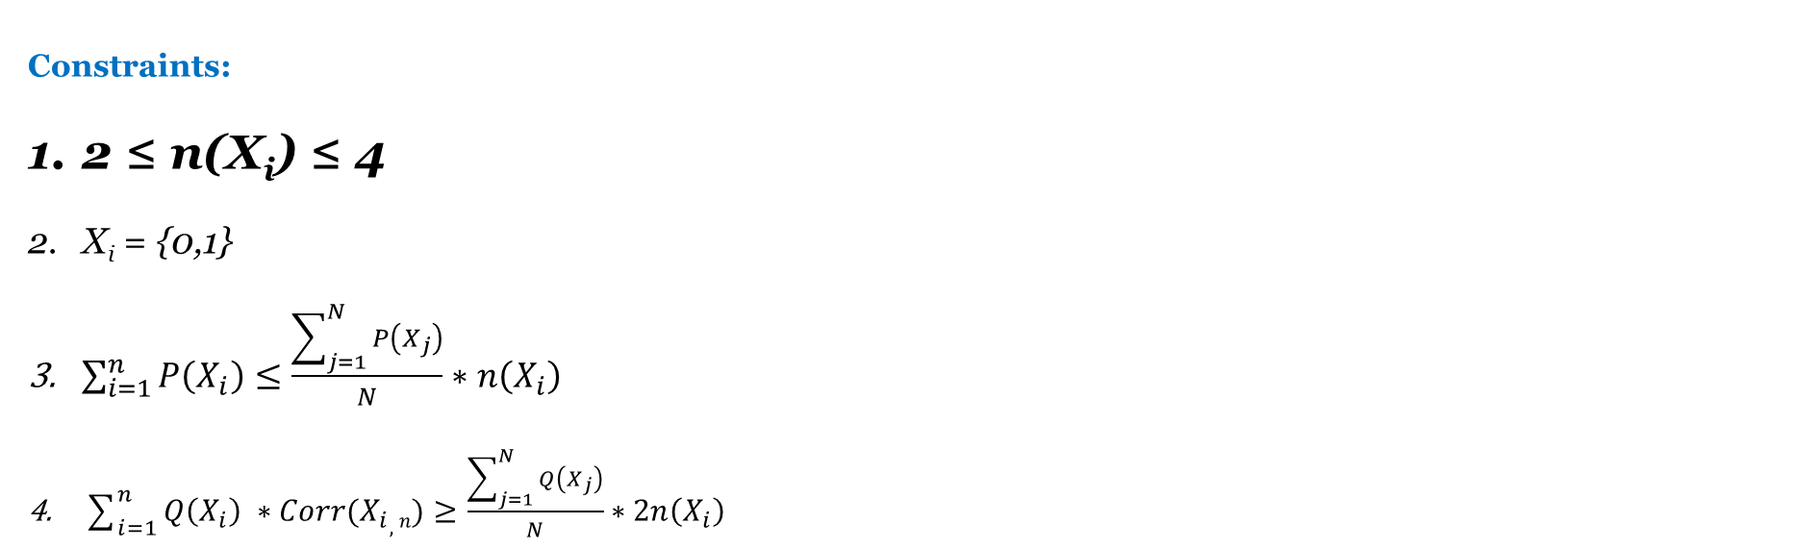
Framing of Optimization Problem
Objective Function:
Max Z = $\sum_{i=1}^{n}{\left[P(Xi)∗Q(Xi)∗D(Xi)∗\left(1.1\right)\right]+\left[P(Xi)∗Q(Xi)∗(1−D(Xi))\right]}$ P(X_{i}) is product sales Price
Q(X_{i}) is Quantities sold for each Product
D(X_{i}) is the Decision variable (0 or 1)
Decision Variables:
List of X_{i} to include to form PPG bundle. X_{i} is individual product
Constraints:
2 ≤ n(X_{i}) ≤ 4
X_{i} = {0,1}
$\sum_{i=1}^{n}{P\left(X_{i}\right)}≤\frac{\sum_{j=1}^{N}{P\left(X_{j}\right)}}{N}∗n\left(X_{i}\right)$
$\sum_{i=1}^{n}{Q\left(X_{i}\right) ∗Corr(X_{i},n)}≥\frac{\sum_{j=1}^{N}{Q\left(X_{j}\right)}}{N}∗2n\left(X_{i}\right)$
Constraint 1:
There are at-least 2 distinct products in a PPG and at-most 4 distinct products in a PPG
`

Slide 12
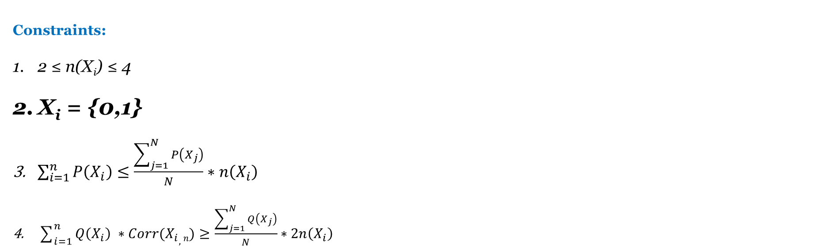
Framing of Optimization Problem
Objective Function:
Max Z = $\sum_{i=1}^{n}{\left[P(Xi)∗Q(Xi)∗D(Xi)∗\left(1.1\right)\right]+\left[P(Xi)∗Q(Xi)∗(1−D(Xi))\right]}$ P(X_{i}) is product sales Price
Q(X_{i}) is Quantities sold for each Product
D(X_{i}) is the Decision variable (0 or 1)
Decision Variables:
List of X_{i} to include to form PPG bundle. X_{i} is individual product
Constraints:
2 ≤ n(X_{i}) ≤ 4
X_{i} = {0,1}
$\sum_{i=1}^{n}{P\left(X_{i}\right)}≤\frac{\sum_{j=1}^{N}{P\left(X_{j}\right)}}{N}∗n\left(X_{i}\right)$
$\sum_{i=1}^{n}{Q\left(X_{i}\right) ∗Corr(X_{i},n)}≥\frac{\sum_{j=1}^{N}{Q\left(X_{j}\right)}}{N}∗2n\left(X_{i}\right)$
Constraint 2:
Xi can take only binary values i.e. 0 or 1.
0 indicates that the product should not be included in the PPG whereas 1 indicates that the product should be included in the new PPG.
`

Slide 13
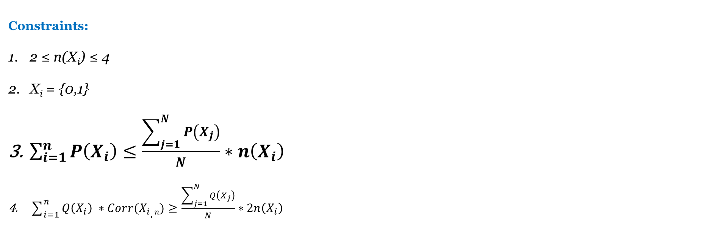
Framing of Optimization Problem
Objective Function:
Max Z = $\sum_{i=1}^{n}{\left[P(Xi)∗Q(Xi)∗D(Xi)∗\left(1.1\right)\right]+\left[P(Xi)∗Q(Xi)∗(1−D(Xi))\right]}$ P(X_{i}) is product sales Price
Q(X_{i}) is Quantities sold for each Product
D(X_{i}) is the Decision variable (0 or 1)
Decision Variables:
List of X_{i} to include to form PPG bundle. X_{i} is individual product
Constraints:
2 ≤ n(X_{i}) ≤ 4
X_{i} = {0,1}
$\sum_{i=1}^{n}{P\left(X_{i}\right)}≤\frac{\sum_{j=1}^{N}{P\left(X_{j}\right)}}{N}∗n\left(X_{i}\right)$
$\sum_{i=1}^{n}{Q\left(X_{i}\right) ∗Corr(X_{i},n)}≥\frac{\sum_{j=1}^{N}{Q\left(X_{j}\right)}}{N}∗2n\left(X_{i}\right)$
Constraint 3:
Price of the new PPG formed should not be too expensive (In other words, we don’t want to form PPGs with highest price). To do this we took sum of individual price that form the PPG which should be less than the average price of products within that sub-category times the number of products in the sub-category.
`

Slide 14
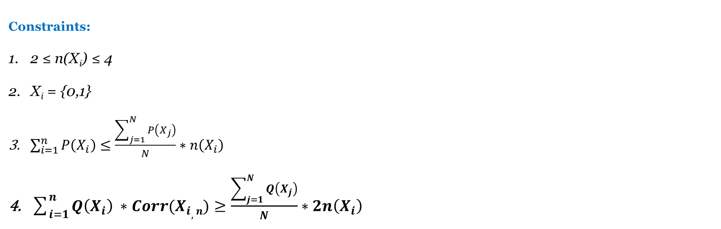
Framing of Optimization Problem
Objective Function:
Max Z = $\sum_{i=1}^{n}{\left[P(Xi)∗Q(Xi)∗D(Xi)∗\left(1.1\right)\right]+\left[P(Xi)∗Q(Xi)∗(1−D(Xi))\right]}$ P(X_{i}) is product sales Price
Q(X_{i}) is Quantities sold for each Product
D(X_{i}) is the Decision variable (0 or 1)
Decision Variables:
List of X_{i} to include to form PPG bundle. X_{i} is individual product
Constraint 4:
Corr (X_{i,n}) refers to the Selling Correlation between two products. For now, we have taken that to be 10%. This can be altered with availability of more data.
E.g. – If A & B are sold separately, quantity sold are x & y respectively. However, if they are sold together, then total quantity sold will be 1.1 * (x+y). The factor of 1.1 suggests that the products compliment each other.
Total quantity sold for the PPG should be higher than twice the average quantity sold earlier without forming PPG.
Constraints:
2 ≤ n(X_{i}) ≤ 4
X_{i} = {0,1}
$\sum_{i=1}^{n}{P\left(X_{i}\right)}≤\frac{\sum_{j=1}^{N}{P\left(X_{j}\right)}}{N}∗n\left(X_{i}\right)$
$\sum_{i=1}^{n}{Q\left(X_{i}\right) ∗Corr(X_{i},n)}≥\frac{\sum_{j=1}^{N}{Q\left(X_{j}\right)}}{N}∗2n\left(X_{i}\right)$
`

Slide 15
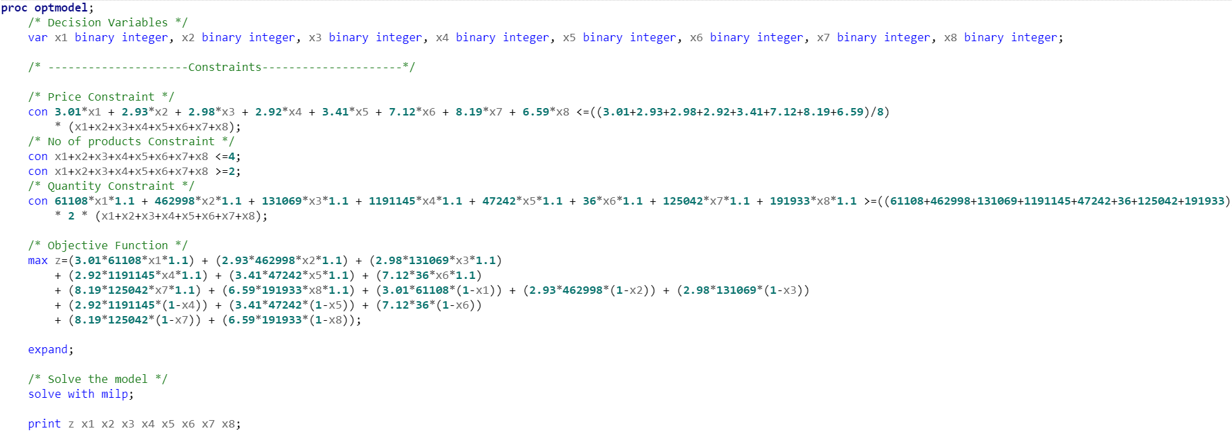
OPTIMIZATION FOR SANITISER – SAS CODE
`

Slide 16
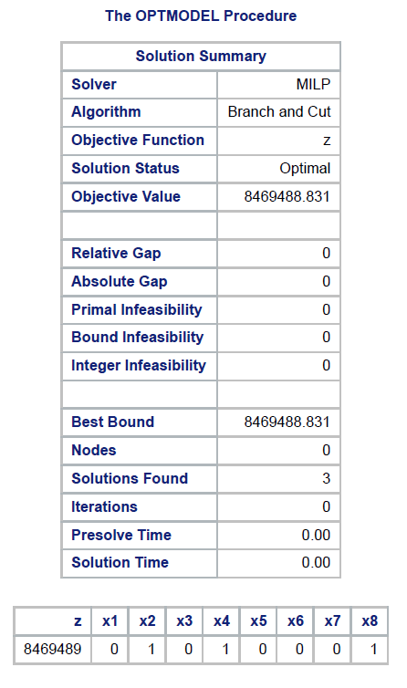
OPTIMIZATION FOR SANITISER – RESULTS
`

Slide 17
OPTIMIZATION – PPG Bundles for Select Categories
Sanitiser
Cleaning Wipes
Prod_2
Prod_4
Prod_8
Prod_2
Prod_4
Prod_7
* Product names hidden for confidentiality purposes
`

Slide 18
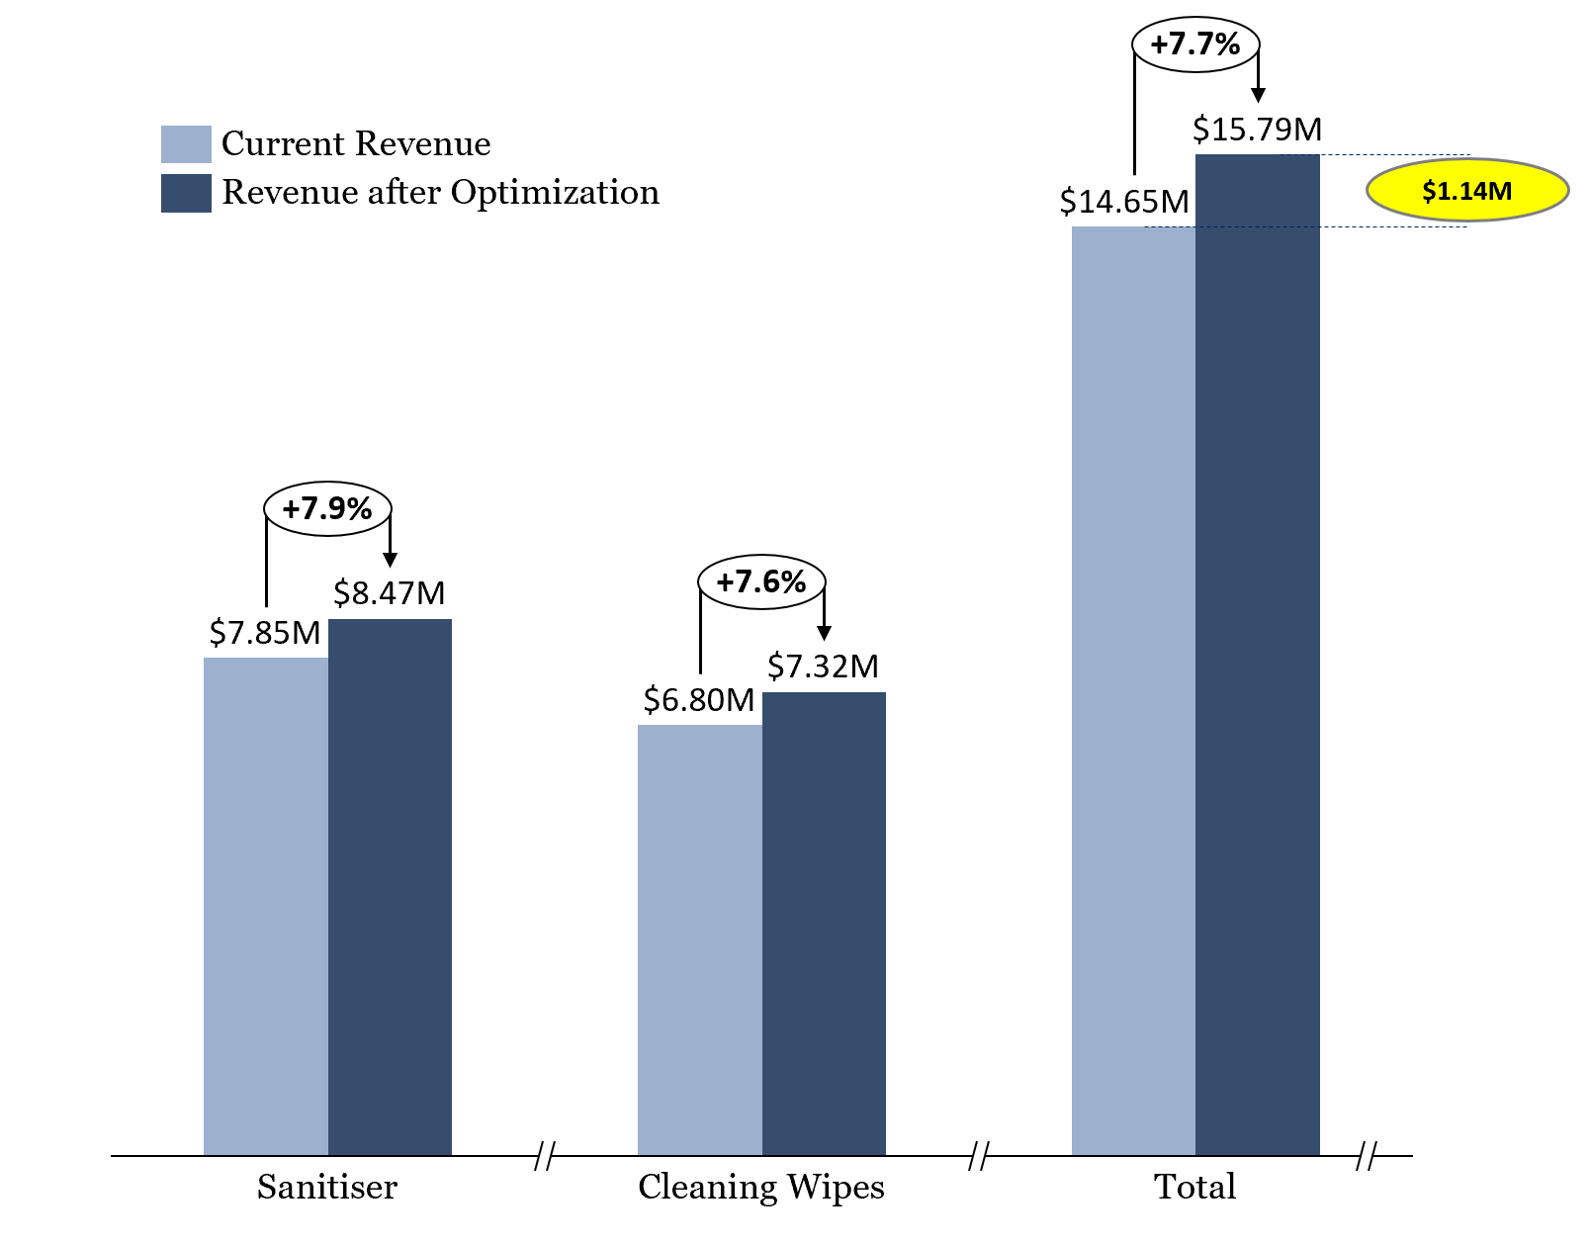
SUB-CATEGORY OPTIMIZATION RESULTS
`

Slide 19
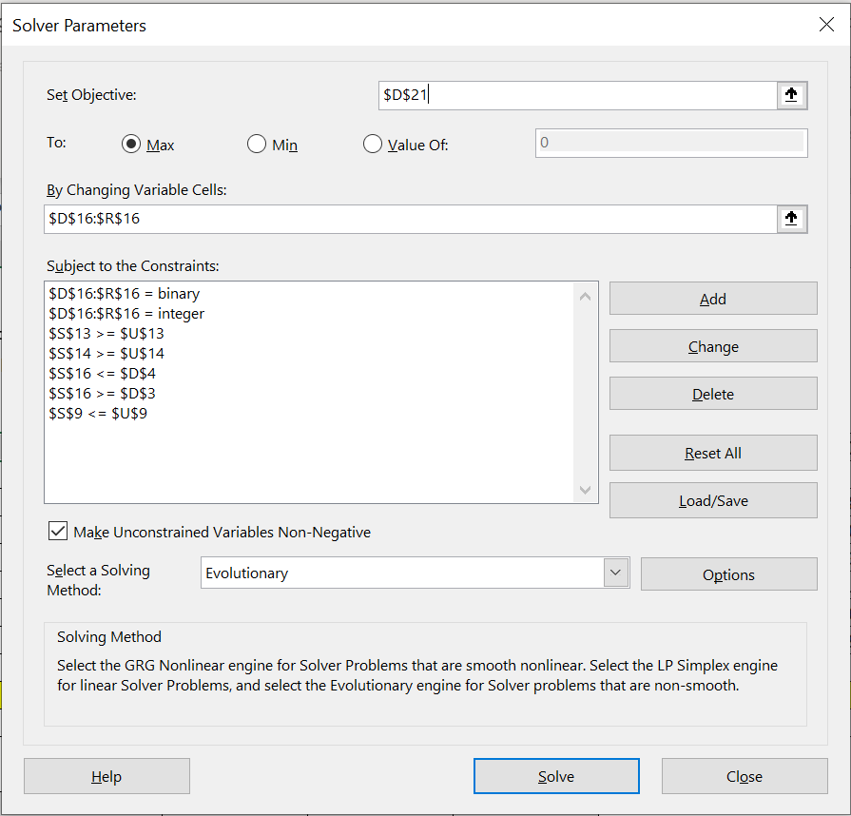
OPTIMIZATION – PROTOTYPE ON EXCEL SOLVER
Objective Function
Decision Variables
Constraint 2
Constraint 4
Constraint 5
Constraint 1
Constraint 3
Solving Method
`

Slide 20
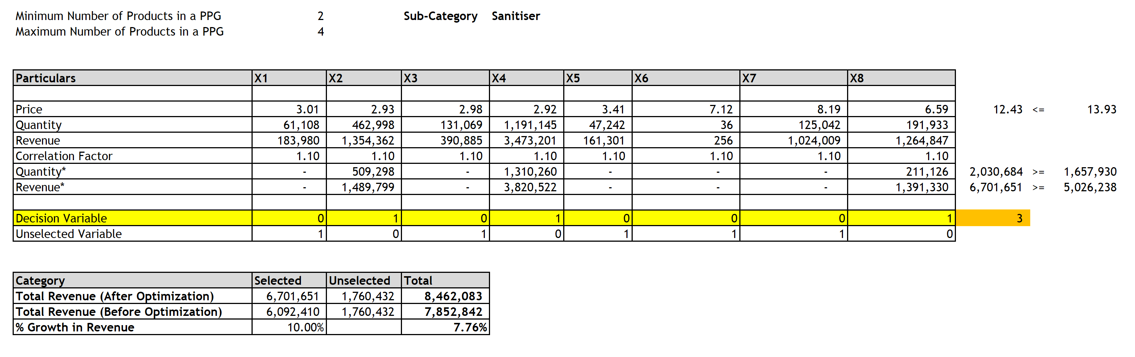
OPTIMIZATION IN EXCEL - SANITISER
`

Slide 21
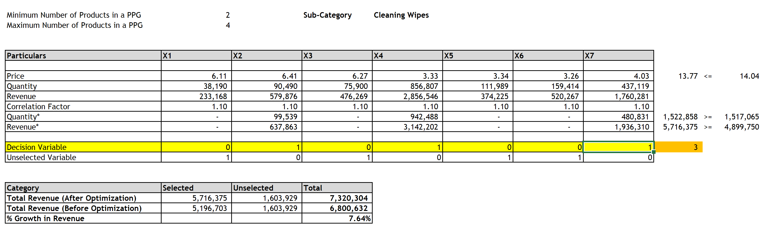
OPTIMIZATION IN EXCEL – CLEANING WIPES
`

Slide 22
OPTIMIZATION – VALIDATION WITH EXCEL
`

Slide 23
AGENDA
Introduction and Problem Statement
Modeling and Results
Future Scope
`

Slide 24
FUTURE SCOPE
Manufacturing Cost of Product – We can calculate product margin, use it in the analysis and optimization to improve the model
Store wise analysis – Analyzing transactions from individual stores to identify demographic data to provide personalized promotional recommendations to boost sales
Customer Transaction Analysis – If we obtain transactional data of customer spending, we can use Market Basket Analysis to uncover associations between items
`

